Slide 1
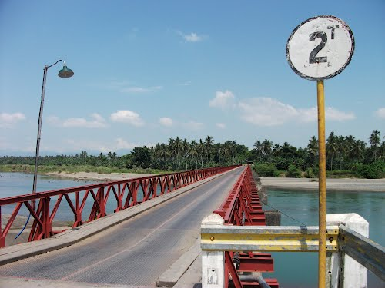
© tripmondo.com

Slide 2
rmn breaking news

Slide 3
you can use this for headlines

Slide 4
